Slide 1



SUPPLY CHAIN
DATASET ANALYSIS PROPOSAL
BY POWER BI

Slide 2

CASE STUDY
This dataset includes customer orders with details on transaction types, shipping schedules, and delivery statuses. It tracks customer information, order specifics like product details and prices, and geographical data. It also records order and shipment timestamps, along with sales and discounts. Key metrics include delivery risks, product availability, and order statuses.
DEPI
Supply Chain
DATASET ANALYSIS PROPOSAL

Slide 3

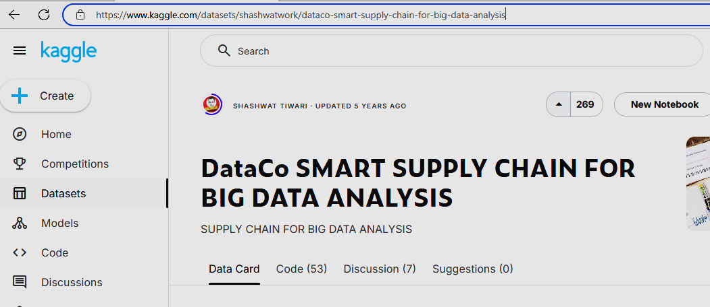


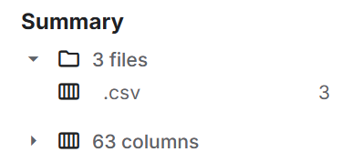
Data Source
We Use DATACO Global Company Data From Kaggle
DataCo SMART SUPPLY CHAIN FOR BIG DATA ANALYSIS | Kaggle

Slide 4
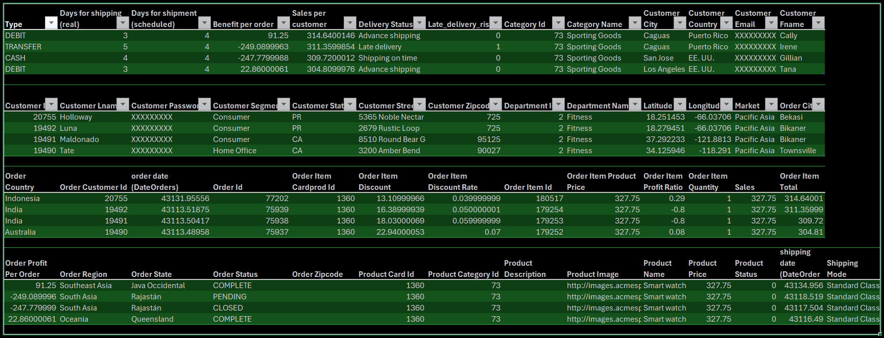
The Data set description
DEPI
We have data set 3 files contain 63 columns
Supply Chain
DATASET ANALYSIS PROPOSAL

Slide 5

Inventory Turnover
Fill Rate
Top Key Performance Indicators (KPIs) for Supply Chain Analysis
Order Fulfillment Cycle Time
Order Accuracy
Supply Chain Cycle Time
On-time Delivery
Perfect Order Rate
Return Rate
Days Sales Outstanding (Dso(
Supplier Lead Time
Freight Cost Per Unit
Backorder Rate

Slide 6
Key Performance Indicators (KPIs) according to our data
Sales and Revenue KPIs
Customer KPIs
Order and Fulfillment KPIs
Product and Category KPIs
Profitability KPIs
Market and Regional KPIs
Operational KPIs
DEPI
Supply Chain
DATASET ANALYSIS PROPOSAL

Slide 7
Key Performance Indicators (KPIs) according to our data
Sales and Revenue KPIs
1-Total Sales
2-Average Order Value (AOV)
3- Sales per Customer
4- Profit per Order
Description: The total amount of sales made over a specific period.
Calculation: Sum of Sales
Description: The average amount spent by customers per order.
Calculation: Total Sales / Number of Orders.
Description: The average sales generated by each customer.
Calculation: Sum of Sales per customer
Description: The average profit made per order.
Calculation: Sum of Order Profit Per Order.
DEPI
Supply Chain
DATASET ANALYSIS PROPOSAL

Slide 8
Key Performance Indicators (KPIs) according to our data
Customer KPIs
1-Customer Lifetime Value (CLV):
2- Customer Retention Rate
Description: The total revenue expected from a customer over their lifetime.
Calculation: Sum of Benefit per order for each customer over their relationship period.
Description: The percentage of customers who continue to buy from you over a given period.
Calculation: ((Number of Customers at End of Period - New Customers Acquired During Period) / Number of Customers at Start of Period) * 100.
DEPI
Supply Chain
DATASET ANALYSIS PROPOSAL

Slide 9
Key Performance Indicators (KPIs) according to our data
Order and Fulfillment KPIs
1-On-time Delivery Rate
2-Late Delivery Risk
3- Average Shipping Time
4- Fulfillment Efficiency
Description: The percentage of orders delivered on or before the scheduled delivery date.
Calculation: (Number of Orders Delivered On-time / Total Orders) * 100.
Description: The percentage of orders at risk of late delivery.
Calculation: (Number of Orders with Late delivery risk / Total Orders) * 100.
Description: The average time taken to ship an order
Calculation: Average of Days for shipping (real).
Description: The efficiency of the order fulfillment process.
Calculation:(Sum of Days for shipment (scheduled) - Sum of Days for shipping (real)) /Total Orders.
DEPI
Supply Chain
DATASET ANALYSIS PROPOSAL

Slide 10
Key Performance Indicators (KPIs) according to our data
Product and Category KPIs
1-Top Selling Products
2- Product Return Rate
3- Category Performance
Description: The products with the highest sales.
Calculation: Identify products with the highest Sales.
Description: The percentage of products returned by customers.
Calculation: (Number of Returned Products / Total Products Sold) * 100.
Description: The sales performance of each product category.
Calculation: Sum of Sales for each Category Id or Category Name.
DEPI
Supply Chain
DATASET ANALYSIS PROPOSAL

Slide 11
Key Performance Indicators (KPIs) according to our data
Profitability KPIs
1-Gross Profit Margin
2- Net Profit Margin
Description: The percentage of revenue that exceeds the cost of goods sold (COGS).
Calculation: (Total Revenue - COGS) / Total Revenue * 100
Description: The percentage of revenue that remains as profit after all expenses are deducted.
Calculation: (Net Profit / Total Revenue) * 100.
DEPI
Supply Chain
DATASET ANALYSIS PROPOSAL

Slide 12
Key Performance Indicators (KPIs) according to our data
Market and Regional KPIs
1-Market Share
2- Regional Sales Performance
Description: The company's sales as a percentage of the total market sales.
Calculation: (Company Sales / Total Market Sales) * 100.
Description: Sales performance across different regions.
Calculation: Sum of Sales for each Order Region or Order State.
DEPI
Supply Chain
DATASET ANALYSIS PROPOSAL

Slide 13
Key Performance Indicators (KPIs) according to our data
Timeline Performance
1.Trend Analysis:
2.Order Processing:
3.Supplier Performance:
4.Operational Efficiency:
Sales Trends: Analyze the fluctuations in sales over time to identify peak seasons and slow periods.
Demand Forecasting: Use historical data to predict future demand.
Lead Time: Analyze the time between order placement and delivery.
Delivery Times: Evaluate the consistency and reliability of suppliers over time
Cycle Time: Measure the time taken for key processes in the supply chain.
DEPI
Supply Chain
DATASET ANALYSIS PROPOSAL

Slide 14

Research Questions
Sales and Revenue Analysis
1- How are sales trends evolving over time?
• Analyze Sales data over different time periods (monthly, quarterly, yearly) to identify
trends and patterns.
2- Which products or categories generate the most revenue?
• Compare Sales across different Product Name and Category Name to identify top
performers.
3- What is the average order value and how does it vary by customer segment?
• Calculate the Average Order Value (AOV) and analyze it by Customer Segment.
4- What are the profit margins for different products?
• Analyze Order Profit Per Order for different Product Name and Category Name

Slide 15
Research Questions
Customer Analysis
5- What is the customer retention rate?
• Determine how many customers are repeat buyers using Customer Id.
6- What is the lifetime value of our customers?
• Calculate the Customer Lifetime Value (CLV) based on Benefit per order.
7- Which customer segments are most profitable?
• Compare Profit per order across different Customer Segment.
8- How does customer location affect sales?
• Analyze Sales data by Customer City, Customer State, and Customer Country

Slide 16
Research Questions
Order and Fulfillment Analysis
9- What is the average shipping time and how does it affect customer loyalty?
• Analyze Days for shipping (real) and Delivery Status to evaluate shipping performance.
10- What percentage of orders are delivered late?
• Calculate the proportion of orders with Late_delivery_risk.
11- What are the main causes of delayed shipments?
• Investigate the reasons behind variations in Days for shipping (real) vs. Days for
shipment (scheduled).
12- How does order statue rate vary across different regions?
• Compare the Order Status across Order Region.

Slide 17
Research Questions
Product and Category Analysis
13- Which product categories have the highest return rates?
• Analyze the Product Status to identify categories with high return rates.
14- How do product prices influence sales volume?
• Compare Product Price with Order Item Quantity to see how pricing affects sales.
Market and Regional Analysis
15- How do sales vary across different markets?
• Analyze Sales data by Market.
16- Which regions generate the most revenue?
• Compare Sales across different Order Region and Order State.

Slide 18
Research Questions
Operational Efficiency Analysis
17- What is the efficiency of our order fulfillment process?
• Evaluate Fulfillment Efficiency by comparing Days for shipment (scheduled) with
Days for shipping (real).
18- How do shipping modes affect delivery times and costs?
• Analyze Shipping Mode, Days for shipping (real), and shipping costs.

Slide 19


Analysis Method
01
Techniques and Tools: The analysis will employ descriptive statistics, trend analysis, and
regression analysis using Power BI
Data Cleaning and Preparation: Missing values and outliers will be addressed through
data cleaning techniques to ensure the accuracy of the analysis.
02

Slide 20


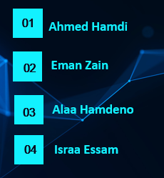
Home
Service
About Us
Contact
This Project Is Brought To You By Group 2 (ALX2_DAT2_G1)
01

Slide 21
THANK YOU!
DEPI
Supply Chain
DATASET ANALYSIS PROPOSAL

